Slide 1
Sprint 1
Angry Petz
David Dacosta
Robert Cucchiara

Slide 2
Completed Work
Created a background for the level
Along with Splash Screen & Main Menu
Made character sprites for the players & cat
Rudimentary multiplayer networking
Player movement and spawning working correctly

Slide 3
Not yet completed
Cat ai, both pathfinding and target acquisition
Better looking method and ui for hosting and connecting to lobbies
Cat sprite sheet
Main menu
Player hud
Animation for moving objects not completed

Slide 4
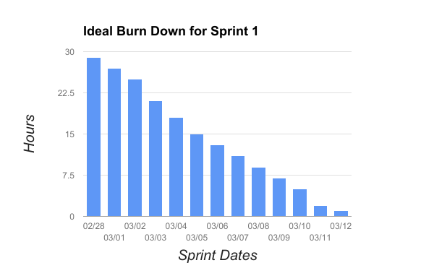
Ideal Burndown

Slide 5
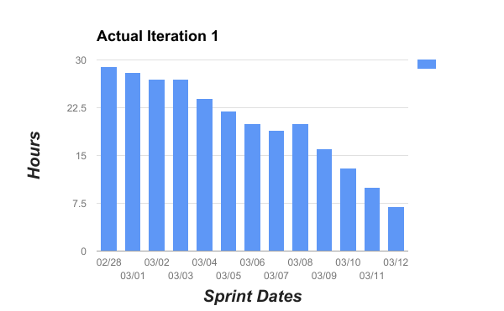
Actual Burndown

Slide 6
Things the team should start doing
Rob
Start using the collab feature in Unity, work on the in game pick ups, ingame ui
Dave
Start utilizing burndown chart and backlog, better communication when it comes to expectations

Slide 7
Things the team should stop and continue doing
We both agreed that nothing was in a state that we should stop working on it and we should just continue on the path that we are on.

